Slide 1
Security in Automobiles: Vulnerability and Protection of the on-board diagnostics port (OBD-II)
Master Thesis. Michiel Willems, 01/02/19

Slide 2
Outline
Introduction
Background
Securing the OBD-II port
Implementation
Evaluation
Conclusion

Slide 3
Introduction

Slide 4
Introduction
Automobile hacking has become one of the major concerns for software security today:
Over 100M lines of code deployed over more than 70 ECU’s.
Networking protocols (e.g. CAN).
Increasing connectability (Bluetooth, Wifi, etc).
Lee Pike, Jamey Sharp, Mark Tullsen, Patrick C. Hickey and James Bielman. 2015.
Securing the automobile: A comprehensive approach.
Dan Klinedinst, Christopher King. 2016
On Board Diagnostics: Risks and Vulnerabilities of the Connected Vehicle
Notes:
Increasing connectability = Emergence of new attack surfaces.

Slide 5
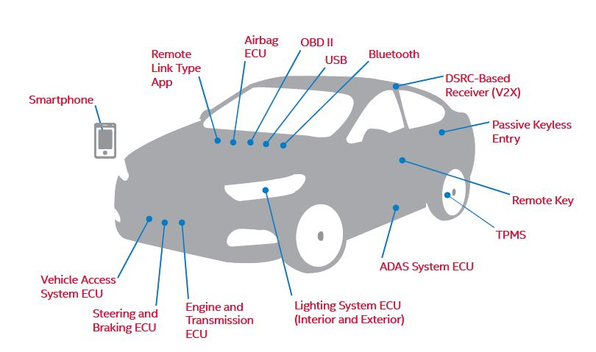
Introduction
Notes:
Some example attack surfaces:
- Bluetooth (Bluetooth large protocol stack, lots of vulnerabilities).
- Tire Pressure Monitoring System: transmit false packets.
- OBD-II is one of these attack surfaces.

Slide 6
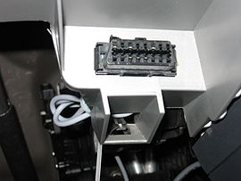
Introduction
On Board Diagnostics Protocol.
Help Technicians Diagnose and Repair Complex Problems
Allows access to vehicle subsystems via connector.
Introduces parameter ID’s (PID) to request data from ECU’s.
PID manufacturer and model specific.
Multiple signalling protocols, Since 2008: ISO 15765 CAN.
https://en.wikipedia.org/wiki/On-board_diagnostics
Allen Lyons, California Air Resources Board , On-Board Diagnostics (OBD) Program Overview, 2015 .

Slide 7



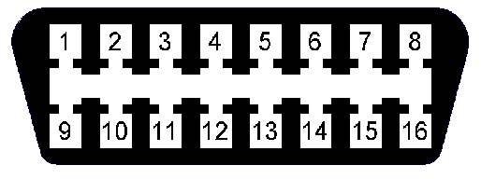
Introduction
Central Gateway
Sub-Networks
CAN
User
Intra Vehicle Network
Notes:
Normal situation: User connects to internal network via OBD-II DLC to retrieve diagnostics info.

Slide 8

Introduction
Central Gateway
Sub-Networks
CAN
Attacker
Intra Vehicle Network
Notes:
Problem: Attackers can also gain access, injecting arbitrary CAN messages.

Slide 9
Introduction
Potential hacking results.
Vehicle Theft.
Changing Emission information (“Dieselgate”).
Reduce odometer value.
Change recorded data after crash.
…
EXTREMETECH, „Hack the diagnostics connector, steal yourself a BMW in 3 minutes
Stephanie Bayer, Thomas Enderle, Dennis Kengo Oka , Marko Wolf .
Security Crash Test – Practical Security Evaluations of Automotive Onboard IT Components

Slide 10
Challenges
Portability
Extant systems, memory footprint, no hardware modifications.
Speed
Practicality, no interference with other systems.
Security
Protect against unauthorised access.

Slide 11
Contribution
Survey vulnerabilities of the OBD-II interface.
The proposal of a role-based access control model for OBD-II, based on public-key cryptography.
Provide open source ‘proof-of-concept’ implementation on resource-constrained hardware and evaluate based on proposed challenges.

Slide 12
Background – Intra vehicle networks

Slide 13
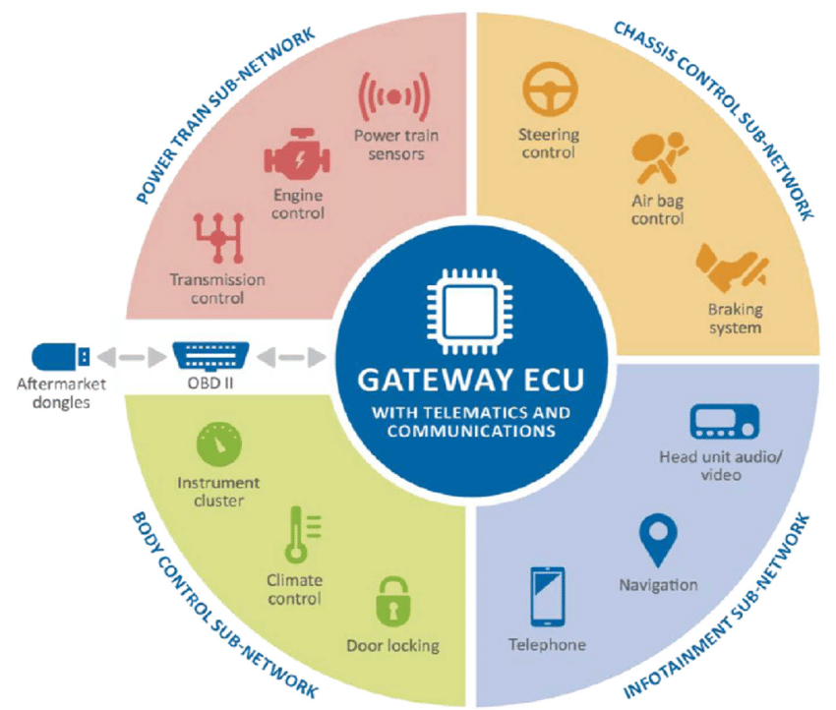
Background – Intra vehicle networks
Cyber security and resilience of smart cars. Technical report, Agency for Network and Information Security (ENISA), 2016.
Notes:
Typical intra vehicle network consists of multiple sub-networks with different responsabilities.
Each sub-network uses a distinct networking protocol that best suit its needs.
Key component = Gateway, performs signal mapping between different sub-networks + Handles incoming OBD-II transmissions.

Slide 14
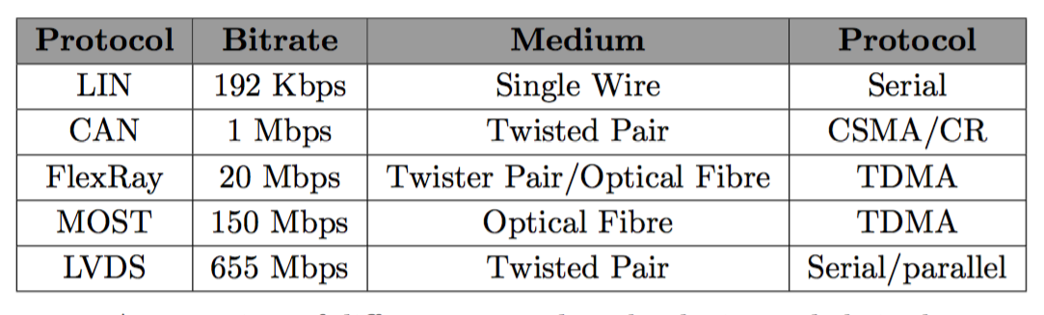
Background – Intra vehicle networks
Shane Tuhoy, Martin Glavin, Ciar ́an Hughes, Edward Jones, Mohan Trivedi, and Liam Kilmartin. Intra-vehicle networks: A review. IEEE Transactions on Intelligent Transportation Systems, January 2014.
Notes:
Example of different networking technologies and their characteristics.

Slide 15
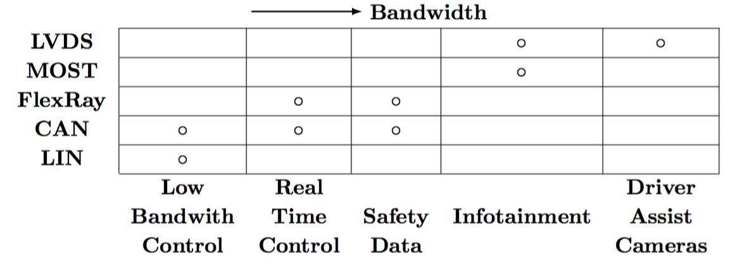
Background – Intra vehicle networks
Shane Tuhoy, Martin Glavin, Ciar ́an Hughes, Edward Jones, Mohan Trivedi, and Liam Kilmartin. Intra-vehicle networks: A review. IEEE Transactions on Intelligent Transportation Systems, January 2014.
Notes:
Which networking protocol is typically used for which sub-network

Slide 16
Background – CAN

Slide 17
Background – CAN
Design goals:
Message arbitration with access to high priority messages.
No master node.
Identifier (ID) identifies content, not sender/receiver.
ID also determines priority.
CAN in Automation (CiA). History of can technology. URL: https://www. can-cia.org/can-knowledge/can/can-history/

Slide 18
Background – CAN
Layers:
Application Layer.
Object Layer.
Transfer Layer.
Physical Layer.
ISO11898-1. Road vehicles – controller area network (can) – part 1: Data link layer and physical signalling. Technical report, International Organization for Standardization, 2015.
ISO11898-2: Road vehicles – controller area network (can) – part 2: High-speed medium access unit. Standard, International Organization for Standardization, 2016.
ISO11898-3: Road vehicles – controller area network (can) – part 3: Low- speed, fault-tolerant, medium-dependent interface. Standard, International Organization for Standardization, 2016.
Notes:
Explain general responsabilities of each layer.

Slide 19
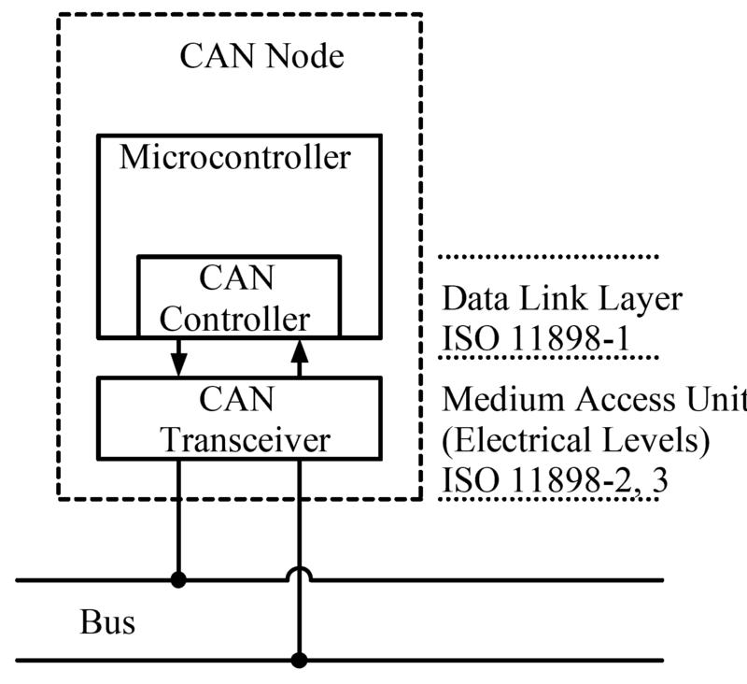
Background – CAN
Architecture:
Wikipedia contributors. Can bus — Wikipedia, the free encyclopedia, 2018. [Online; accessed 29-November-2018]. URL: https://en.wikipedia.org/w/ index.php?title=CAN_bus&oldid=870995924.
Notes:
CAN Transceiver: implements physical layer.
CAN Controller: Transfer layer.
MCU: Object Layer + Application Layer.
CAN node = ECU

Slide 20
Background – CAN
Frames:
Data frame
Error frame
Remote frame
Overload frame
ISO11898-1. Road vehicles – controller area network (can) – part 1: Data link layer and physical signalling. Technical report, International Organization for Standardization, 2015.
ISO11898-2: Road vehicles – controller area network (can) – part 2: High-speed medium access unit. Standard, International Organization for Standardization, 2016.
ISO11898-3: Road vehicles – controller area network (can) – part 3: Low- speed, fault-tolerant, medium-dependent interface. Standard, International Organization for Standardization, 2016.
Notes:
Explain goal of each frame type

Slide 21
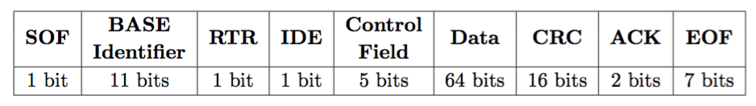
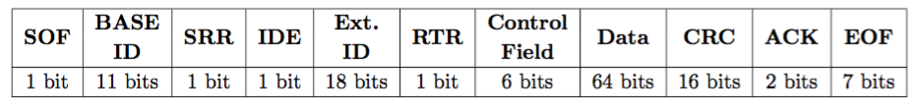
Background – CAN
Frame formats:
ISO11898-1. Road vehicles – controller area network (can) – part 1: Data link layer and physical signalling. Technical report, International Organization for Standardization, 2015.
ISO11898-2: Road vehicles – controller area network (can) – part 2: High-speed medium access unit. Standard, International Organization for Standardization, 2016.
ISO11898-3: Road vehicles – controller area network (can) – part 3: Low- speed, fault-tolerant, medium-dependent interface. Standard, International Organization for Standardization, 2016.
Notes:
2 types: BASE type and Extended type.
Difference: extended has longer id (29 instead of 11)
Max Data of 8 bytes.

Slide 22
Background – CAN
Message Arbitration:
CAN ID bit either dominant (0) or recessive (1).
Upon multiple concurrent transmission: arbitration.
Lower ID = Higher priority.
ISO11898-1. Road vehicles – controller area network (can) – part 1: Data link layer and physical signalling. Technical report, International Organization for Standardization, 2015.
ISO11898-2: Road vehicles – controller area network (can) – part 2: High-speed medium access unit. Standard, International Organization for Standardization, 2016.
ISO11898-3: Road vehicles – controller area network (can) – part 3: Low- speed, fault-tolerant, medium-dependent interface. Standard, International Organization for Standardization, 2016.
Notes:
Explain how message arbitration works.

Slide 23
Background – CAN
Security Issues:
Eavesdropping
No authentication
No encryption
Denial of service (DoS)
Byzantine faults
Robert Buttigieg, Mario Farrugia, and Clyde Meli. Security issues in controller area networks in automobiles. Technical report, University of Malta, 2017.
Stephen Checkoway, Damon McCoy, Brian Kantor, Danny Anderson, Hovav Shacham, Stefan Savage, Karl Koscher, Alexei Czeskis, Franziska Roesner, and Tadayoshi Kohno.
Comprehensive experimental analyses of automotive attack surfaces. Technical report, University of California, San Diego and University of Washington.

Slide 24
Background – OBD-II

Slide 25
Background – OBD-II
Design goals:
Standardisation
Certification
Lower emissions
ISO15031-1: Road vehicles -- Communication between vehicle and external equipment for emissions-related diagnostics -- Part 1: General information and use case definition. 2010.

Slide 26
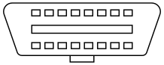
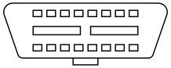
Background – OBD-II
Data Link Connector (DLC)
Type A
Type B
ISO15031-3. Road vehicles – communication between vehicle and external equipment for emissions-related diagnostics – part 3: Diagnostic connector and related electrical circuits: Specification and use. Standard, International Organization for Standardization, 2016.
Wikipedia contributors. On-board diagnostics — Wikipedia, the free encyclopedia, 2018. [Online; accessed 29-November-2018]. URL: https://en.wikipedia. org/w/index.php?title=On-board_diagnostics&oldid=870086948.
Notes:
Both are female connectors (found in vehicles)
law it is required to be installed within 0.61 m of the steering wheel
Type A uses 12V signal levels.
Type B uses 24V signal levels.
Design prevents insertion of type A male plug into a type B female socket

Slide 27
Background – OBD-II
Parameter ID’s (PID) to request data.
Diagnostic trouble codes (DTC) to identify faults.
Signalling protocols to handle communications.
Hardware tools and adaptors.
ISO15031-5. Road vehicles – communication between vehicle and external equipment for emissions-related diagnostics – part 5: Emissions-related diagnostic services. Standard, International Organization for Standardization, 2015.
ISO15031-6. Road vehicles – communication between vehicle and external equipment for emissions-related diagnostics – part 6: Diagnostic trouble code definitions. Standard, International Organization for Standardization, 2015.
Wikipedia contributors. On-board diagnostics — Wikipedia, the free encyclopedia, 2018. [Online; accessed 29-November-2018]. URL: https://en.wikipedia. org/w/index.php?title=On-board_diagnostics&oldid=870086948.
Notes:
Hardware tools different types: standard OBD-II diagnostics tool, one with bluetooth/wifi compatability, one with USB connector.

Slide 28
Background – OBD-II
DLC
Central Gateway
Sub-Networks
CAN
User
Diagnostic
scanning tool
Intra Vehicle Network
Notes:
Give example of how OBD-II works.

Slide 29
Background – OBD-II
Signalling Protocol ISO 15765 CAN (ISO-TP).
Speed: 250 or 500 kbit/sec.
Message length up to 4095 bytes.
Split message up into different CAN frames.
First data byte = Protocol control information (PCI).
4 most significant bits = PCI type.
ISO 15765-2:2016 Road vehicles -- Diagnostic communication over Controller Area Network (DoCAN) -- Part 2: Transport protocol and network layer services, Standard, Internation Organisation for standardization, 2016.

Slide 30
Background – OBD-II
ISO-TP frame types:
Single Frame (SF) = 0.
First Frame (FF) = 1.
Consecutive Frame (CF) = 2.
Flow control Frame (FC) = 3.
ISO 15765-2:2016 Road vehicles -- Diagnostic communication over Controller Area Network (DoCAN) -- Part 2: Transport protocol and network layer services, Standard, Internation Organisation for standardization, 2016.

Slide 31
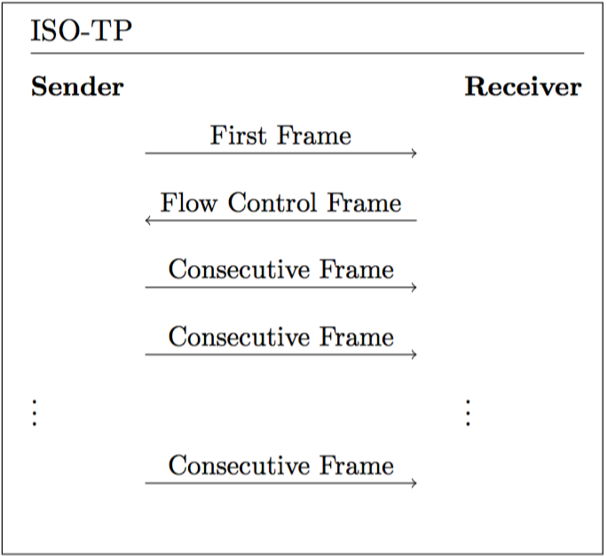
Background – OBD-II
ISO-TP:
ISO 15765-2:2016 Road vehicles -- Diagnostic communication over Controller Area Network (DoCAN) -- Part 2: Transport protocol and network layer services, Standard, Internation Organisation for standardization, 2016.
Notes:
Message longer than 7 bytes.
Consecutive frames until entire payload was delivered.

Slide 32
Background – OBD-II
OBD-II security issues:
Provides direct access to intra vehicle network.
Inherits security issues of underlying signalling protocol (i.e. CAN):
Eavesdropping
Denial of Service
etc.

Slide 33
Background – Preliminaries

Slide 34
Background – OBD-II
Asymmetric key cryptography: ECC, ECDSA and ECDH.
Symmetric key cryptography: HMAC-SHA256.
Cryptographic Hash functions: SHA256 and SHA512.
Notes:
ECC because of it’s speed (make comparison like 26 minutes (RSA DS) versus 6 seconds (ECDSA). Atmega328 microcontroller 16Mhz

Slide 35
Securing the OBD-II port

Slide 36
Attacker Model – Physical Access
Central Gateway
Sub-Networks
CAN
Attacker
Intra Vehicle Network

Slide 37

Attacker Model – Remote Session Hijacking
Central Gateway
Sub-Networks
CAN
User
Attacker
Intra Vehicle Network

Slide 38
Securing the OBD-II port
Attacker Types:
Attack targeting driver/passenger safety.
Vehicle alteration by legitimate users.
Surveillance.
Theft.
Cyber security and resilience of smart cars. Technical report, Agency for Network and Information Security (ENISA), 2016.

Slide 39
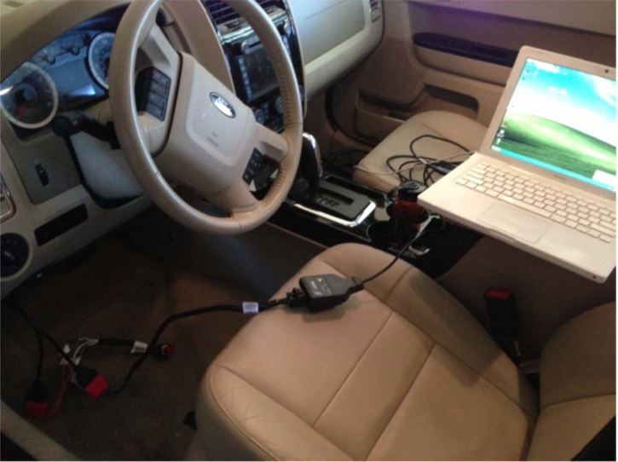
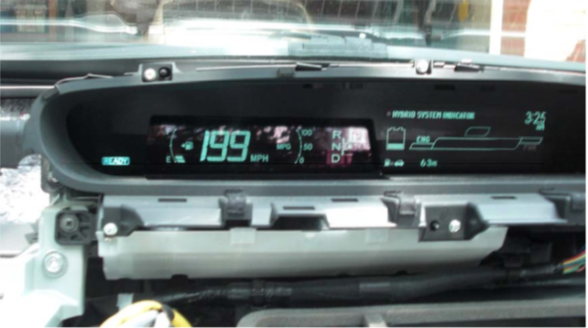
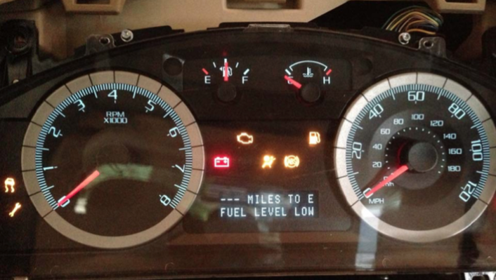
Securing the OBD-II port
Example Attacks:
Speedometer.
Denial of Service.
Diagnostic Session.
Charlie Miller and Chris Valasek. Adventures in automotive networks and control units. 2014.
Notes:
Clicking shows multiple pictures.
Diagnostics session: explain seed key + weakness.

Slide 40

Securing the OBD-II port – Role Based Access Control
Private keys
OBD-II Server
Internet
Connection
Central Gateway
Sub-Networks
CAN
User
Public keys
Intra Vehicle Network
Notes:
OBD-II Role-based access control.
Each public/private key-pair associated with a specific role.
Private keys stored on a obd-II server
Public keys stored on central gateway.
User first authenticates to the OBD-II server (e.g. login and password).
User will facilitate authentication to gateway by proving (s)he has access to OBD-II server (i.e. private key).

Slide 41
Securing the OBD-II port
Authenticated Key Agreement Procedure
Message Authentication Procedure
Permission Table
Notes:
Key aspects of OBD-II RBAC

Slide 42
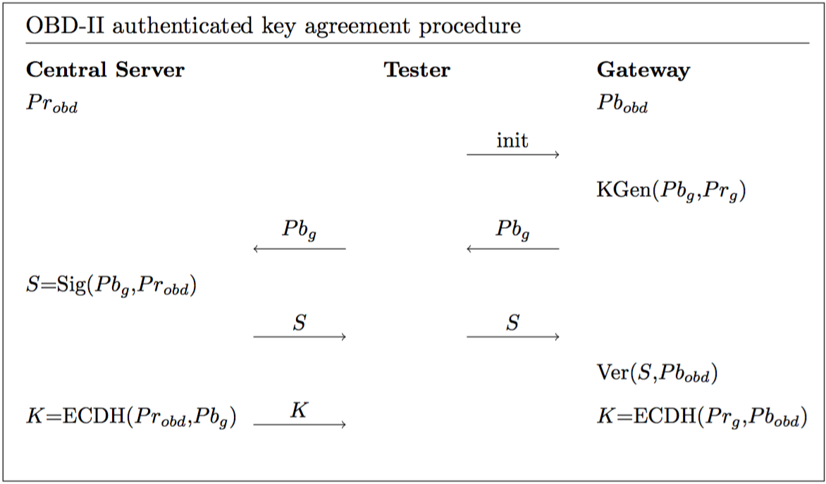
Securing the OBD-II port
Notes:
Discuss procedure
Init message also contains role
Result: Central server authenticated to gateway. (i.e. use has access to central server).
Result: Both tester and gateway calculated shared secret.

Slide 43
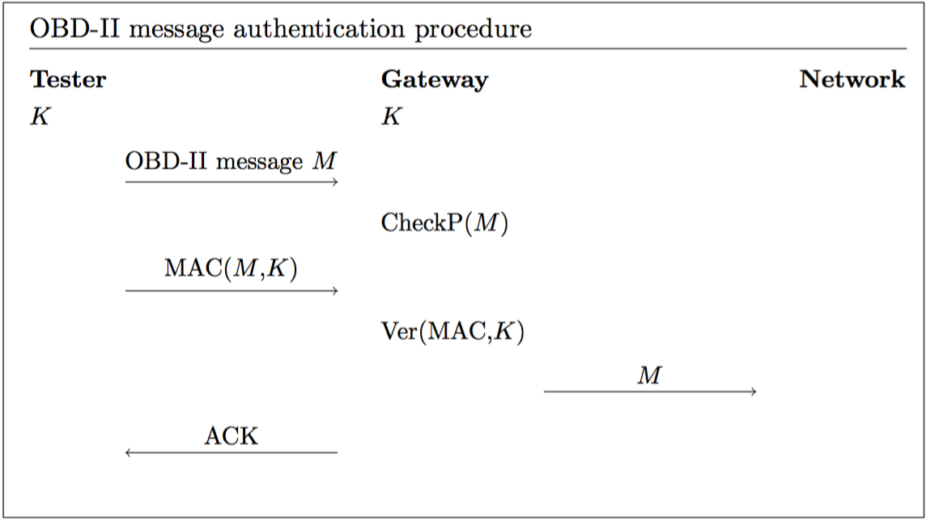
Securing the OBD-II port
Notes:
Discuss procedure

Slide 44
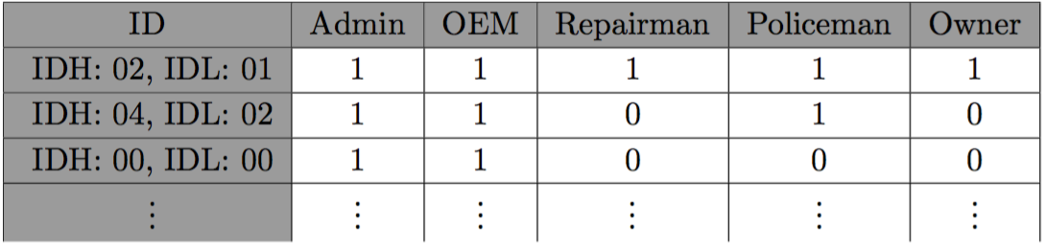
Securing the OBD-II port
Permission Table
Charlie Miller and Chris Valasek. Adventures in automotive networks and control units. 2014
Notes:
Explain different roles: Admin, OEM, Repairman, Policeman, Owner
Examples (2010 Ford Escape):
0201: speedometer
0402: odometer
0000: DoS

Slide 45
Implementation

Slide 46
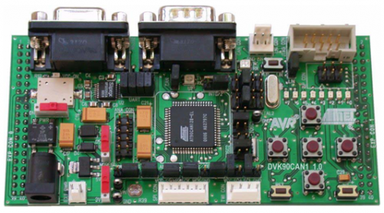
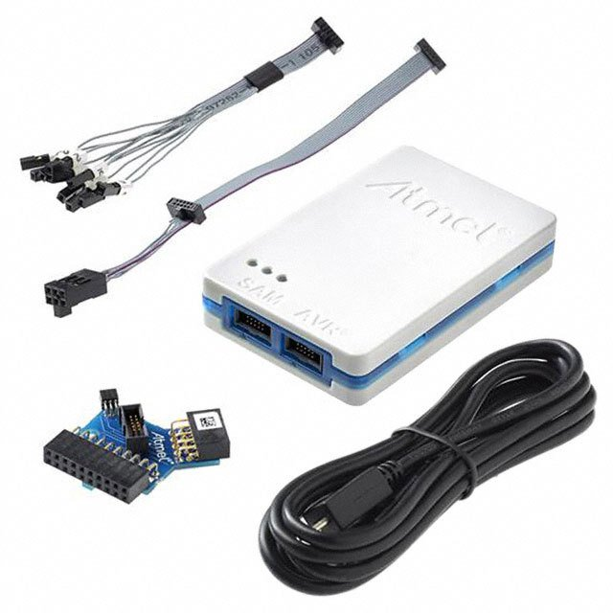
Implementation
Hardware: 2 x DVK90CAN1
AT90CAN128 MCU
CAN Transceiver + Connector
RS-232 driver/receiver + Connector
Compass Card Keyboard
Atmel-ICE Basic Programmer (JTAG)
http://ww1.microchip.com/downloads/en/devicedoc/doc4381.pdf
https://www.microchip.com/developmenttools/ProductDetails/atatmel-ice

Slide 47
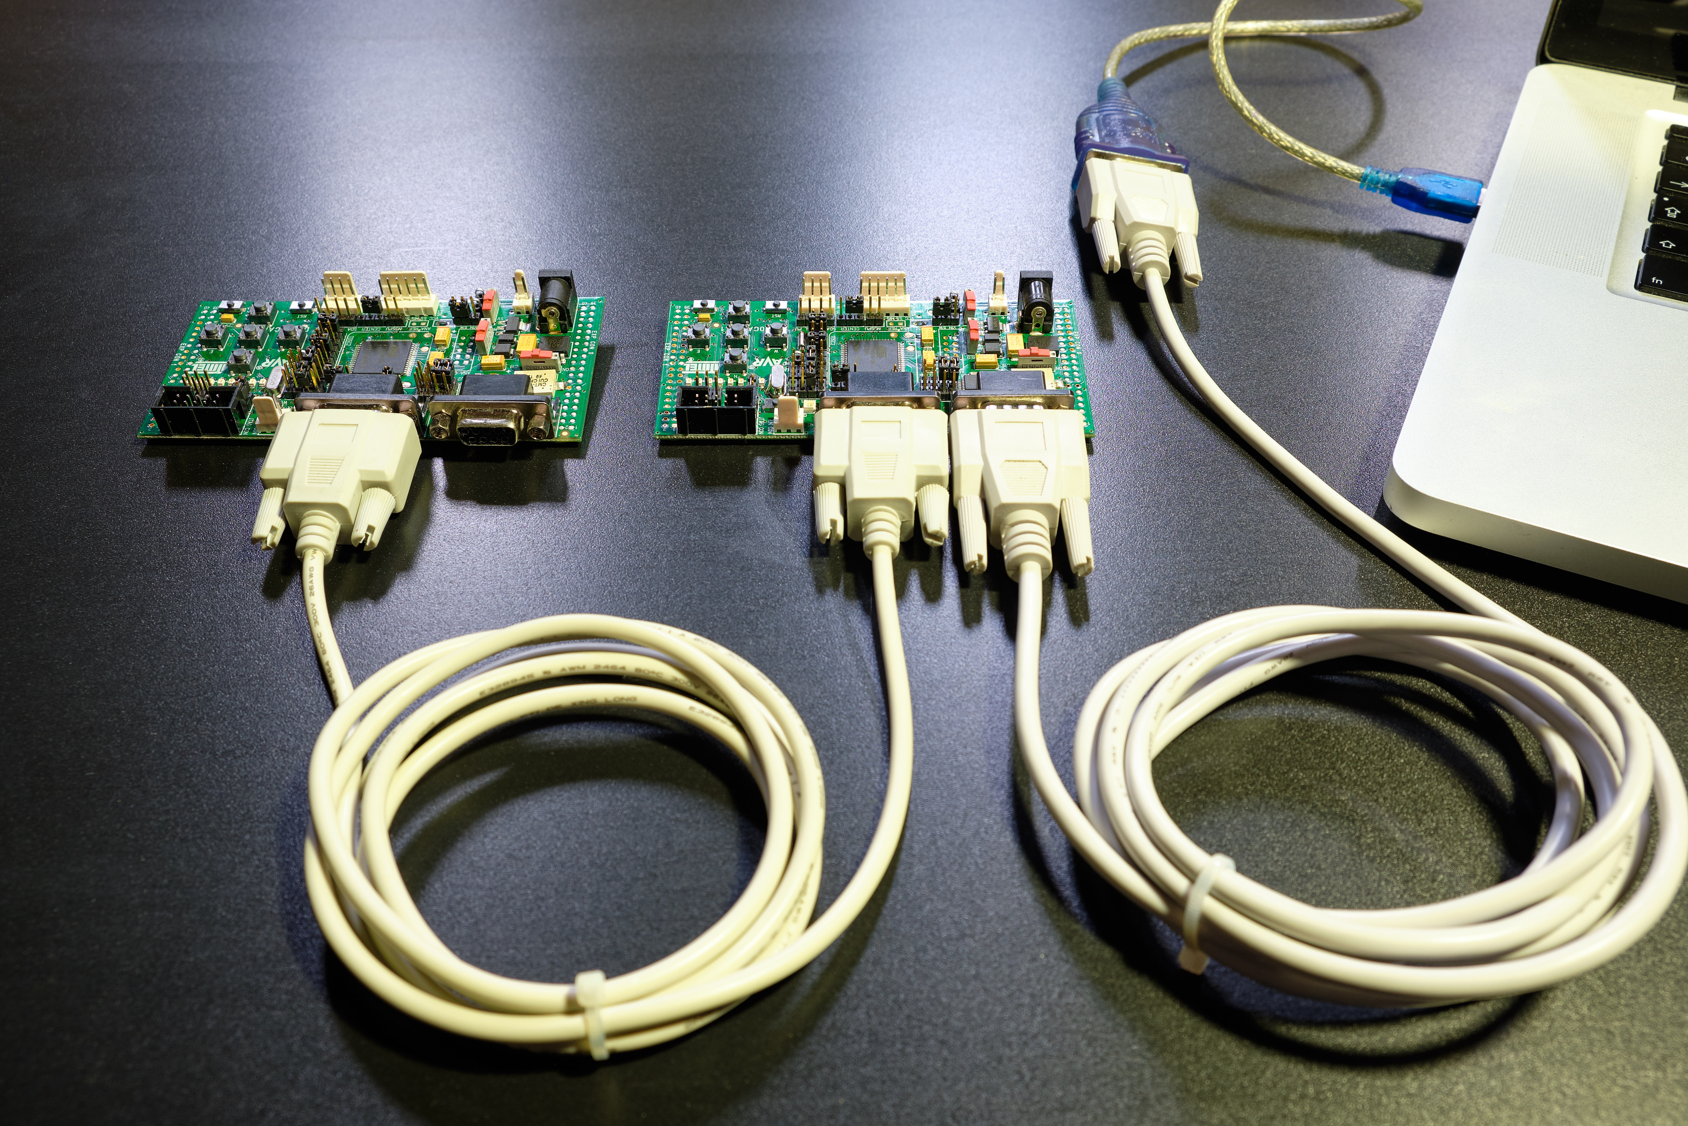
Implementation
Set-Up:
Notes:
OBD-II Server: Implemented on the tester (key API).
Intra vehicle network: RS232 connection with PC.

Slide 48
Implementation
C Libraries:
Micro-ECC for ECC, ECDSA and ECDH.
AVR-Crypto-Lib for SHA256, SHA512 and HMAC-SHA256.
ISOTP-C for ISO-TP.
https://github.com/kmackay/micro-ecc
https://github.com/cantora/avr-crypto-lib
https://github.com/lishen2/isotp-c

Slide 49
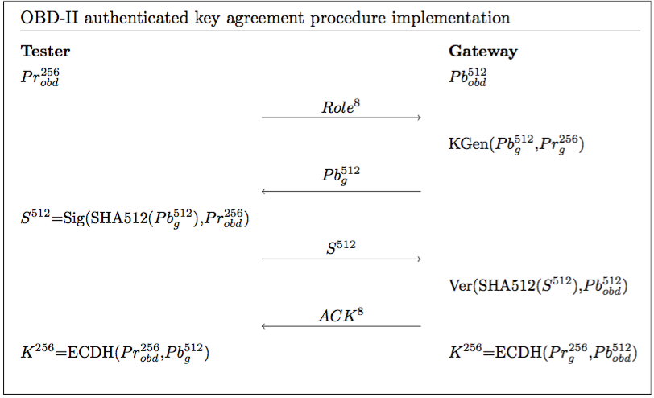
Implementation
Notes:
Discuss implementation (everything is transmitted using ISO-TP!!!)
Security level of 128 bits.
Private/public key size to guarantee security level.
Signature size to guarantee security level.
Shared secret size to guarantee security level.

Slide 50
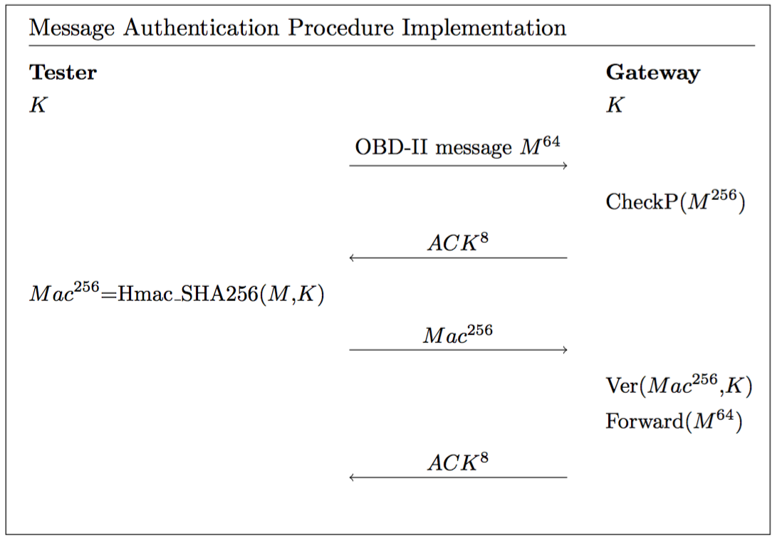
Implementation
Notes:
Discuss implementation(ISO-TP!!!)
Again MAC size to guarantee security level.

Slide 51
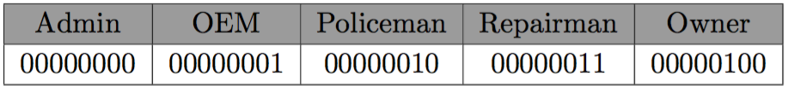
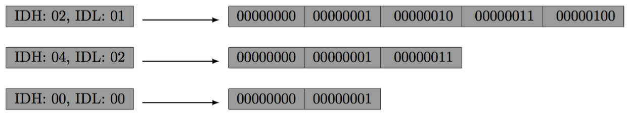
Implementation
Permission Table Implementation

Slide 52
Implementation
Demo: 3 Scenarios
Scenario 1: Authenticate with false key.
Scenario 2: Authenticate as Owner.
Scenario 3: Authenticate as Admin.

Slide 53
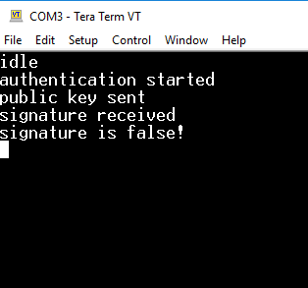
Implementation
Scenario 1
Role: Owner

Slide 54
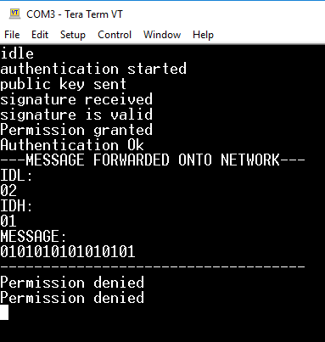
Implementation
Scenario 2
Role: Owner

Slide 55
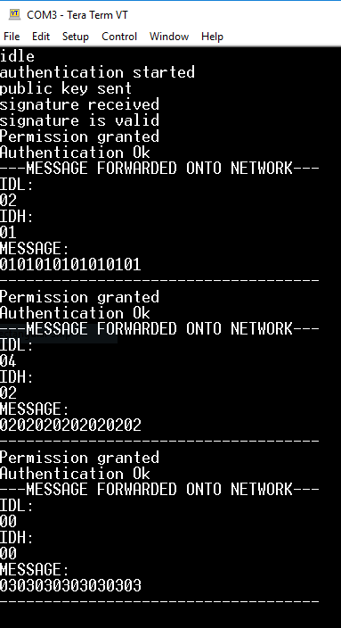
Implementation
Scenario 3

Slide 56
Evaluation

Slide 57
Evaluation
Portability
Extant systems, memory footprint, no hardware modifications.
Speed
Practicality, no interference with other systems.
Security
Protect against unauthorised access.

Slide 58
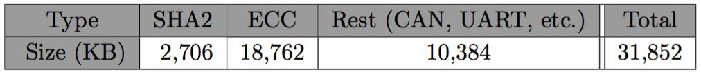
Evaluation
Portability:
Program Memory:
RAM: 3 KB (ECC)
Notes:
32 KB is pessimistic estimate (ISO-TP, CAN, etc already implemented on gateway).
Typical RAM up to several megabytes (so 3KB is ok) (Atmel, Infineon, ST).
Typical Program memory also within acceptable bounds.
Other things I should mention here? No hardware modifications necessary?

Slide 59
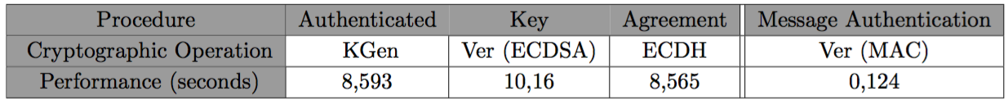
Evaluation
Speed:
ECC operations take significant time.
Decoupling necessary
Notes:
Most important procedures are the cryptographic ones, since each message takes only roughly 1.04 ms (online CAN speed calculator).
ECC operations very slow.
It is necessary to decouple OBD-II authentication and normal Gateway operation (i.e. signal mapping) to prevent system from shutting down.

Slide 60
Evaluation
Security:
Cryptographic primitives
Authenticated key agreement procedure
Random number generation
Message authentication procedure
Central server connection/authentication
Private key disclosure
Memory isolation
Notes:
…
Memory isolation: use TCB architecture to shield RBAC implementation + allow authenticated updates.
Real gateways = Read Only Memory.

Slide 61
Conclusion

Slide 62
Conclusion
Contribution in Review
Survey vulnerabilities of the OBD-II interface.
The proposal of a role-based access control model for OBD-II, based on public-key cryptography.
Provide open source ‘proof-of-concept’ implementation on resource-constrained hardware and evaluate based on proposed challenges.

Slide 63
Conclusion
Future Work
OBD-II Roles
Permission Table
Central Server
Tester and OBD-II Applications

Slide 64
Thank you!

Slide 65
Questions?

Slide 66
Survey vulnerabilities of the OBD-II interface.
The proposal of a role-based access control model for OBD-II, based on public-key cryptography.
Provide open source ‘proof-of-concept’ implementation on resource-constrained hardware and evaluate based on proposed challenges.

Slide 67
Introduction
Automobile hacking has become one of the major concerns for software security today:
Over 100M lines of code deployed over more than 70 ECU’s.
Networking protocols (e.g. CAN).
Increasing connectability (Bluetooth, Wifi, etc).
Lee Pike, Jamey Sharp, Mark Tullsen, Patrick C. Hickey and James Bielman. 2015.
Securing the automobile: A comprehensive approach.
Dan Klinedinst, Christopher King. 2016
On Board Diagnostics: Risks and Vulnerabilities of the Connected Vehicle

Slide 68

OBD-II

Slide 69
Security Issues
No source address => No certainty about origin.
Broadcast nature => Information Disclosure.
Prioritized ID’s => Denial of Service.
No support for encryption or authentication.
’CAN, by design, offers no protection from manipulation’
(Miller, 2013), (Koscher, 2010)

Slide 70


Threat Model
Physical Access to OBD-II DLC.
Ability to inject arbitrary packets.
Able to exploit vulnerabilities in ECU software.
Vehicle Network

Slide 71
OBD-II Access Control

Slide 72
Introduction
Thesis Subject: Role Based Access Control.
Every role determines what kind of access is permitted.
For example:
Repair shop => Read diagnostics information only.
Official dealership => Diagnostics + ability to fix/test faulty ECU’s.
Police => Check integrity of vehicle network.

Slide 73
Introduction
Central Gateway
Private Key
Public Key
Vehicle Network

Slide 74
Introduction
Challenges:
PKI infrastructure.
Authentication protocol (challenge response).
Permissions table.
Secure private key API.

Slide 75
Security, Vulnerability and Protection of Vehicular On-board Diagnostics
Aastha Yadav, Gaurav Bose, Radhika Bhange, Karan Kapoor, N.Ch.S.N Iyengar, Ronnie D. Caytiles
VIT University.Vellore-632014, Tamilnadu, India, Hannam University, Korea

Slide 76
Paper - Introduction
Outline:
Introduction
Motivation
Background Research
Points Entry
On-Board Diagnostic (OBD)-II Port
OBD-II Port Security Threats
Security Solution
Conclusion

Slide 77
Paper - Introduction
Outline:
Introduction
Motivation
Background Research
Points Entry
On-Board Diagnostic (OBD)-II Port
OBD-II Port Security Threats
Security Solution
Conclusion

Slide 78
Security, Vulnerability and Protection of Vehicular On-board Diagnostics
Aastha Yadav, Gaurav Bose, Radhika Bhange, Karan Kapoor, N.Ch.S.N Iyengar, Ronnie D. Caytiles
VIT University.Vellore-632014, Tamilnadu, India, Hannam University, Korea
Proposed Security Solutions

Slide 79
Security Solutions – Seed Key Algorithm
Implement security at ECU level.
Every ECU holds a secret key.
Algorithm:
Tester sends a PID to the ECU.
ECU sends a seed value to the Tester.
Both ECU and Tester calculate response from seed and secret key.
Tester sends response to ECU where it is verified.

Slide 80
Security Solutions – Seed Key Algorithm
Security Issues:
Same secret key shared.
Secret key stored in unprotected memory.
Algorithms are proprietary and Confidential (Security through Obscurity).
Seed values often too short ( 10 min to crack 16 bit seed ).
K. Koscher, A. Czeskis, F. Roesner, S. Patel, T. Kohno, S. Checkoway, D. McCoy, B. Kantor, D.Anderson and H.a.o. Shacham,
"Experimental security analysis of a modern automobile", Security and Privacy (SP), 2010 IEEE Symposium on, (2010).

Slide 81
Security Solutions – Two Way Authentication
Extends Seed-Key Algorithm.
Introduce device that allows client (owner of car) to control access to the OBD-II port.
Device can be a pager, cell phone, smartphone app, bluetooth, etc.
Device allows client to receive and send acknowledgments.

Slide 82
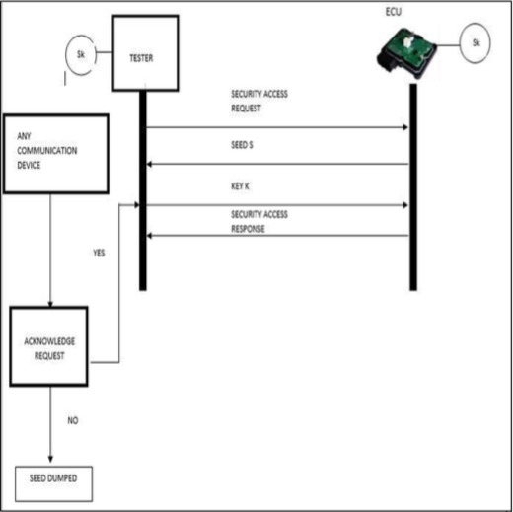
Security Solutions – Two Way Authentication

Slide 83
Security Solutions – Timer Method
Extends Two-Way authentication method.
Introduces 2 things:
Timer started once seed is received, if it runs out the client is notified.
Client needs to enter code when completing acknowledgement.
Timer should prevent brute force attacks.

Slide 84
Paper – My Issues
Solution assumes official tester device.
Custom tester software could use revealed secret keys.
Custom tester software would bypass two-way authentication.
Implementation uses small key and seed sizes.
Demo uses 5 bit seeds and keys.
ECU is implemented only virtually (no CAN).

Slide 85
Current Thesis Status

Slide 86
Current Thesis Status
2 DVK90CAN1 AVR development boards (AT90CAN128).
Gateway:
Holds public keys & permissions table.
Tester:
Implements private key API.
Authenticate & send OBD-II messages.

Slide 87
Current Thesis Status
Authentication Request.
Remote CAN frame
With Specific ID
Tester
Gateway

Slide 88
Current Thesis Status
Challenge
2 CAN Frames
128 bit Challenge
Tester
Gateway

Slide 89
Current Thesis Status
Key Attestation
8 CAN frames
512 bit Signature of Challenge
Tester
Gateway

Slide 90
Current Thesis Status
Elliptic Curve Digital Signature Algorithm.
Key Size:
Security level is Key Size / 2 (smaller key than normal DSA).
According to NSA 256 bit key sufficient (128-bit security level) .
Signature Size:
Security level is Signature size / 4.
A signature of size 512 bit will be sufficient (128-bit security level).
https://en.wikipedia.org/wiki/Key_size#cite_note-19
https://en.wikipedia.org/wiki/Elliptic_Curve_Digital_Signature_Algorithm

Slide 91
Current Thesis Status
Authentication Request.
Remote CAN frame
Acknowledgment
Tester
Gateway

Slide 92
Current Thesis Status
Send OBD-II message
OBD-II message
Tester
Gateway

Slide 93
Current Thesis Status
Former protocol is for sending 1 OBD-II message.
If multiple messages are to be sent shared secret is established:
Elliptic Curve Diffie-Hellman
Shared secret used as new symmetric key.
Every OBD-II message followed by MAC of message using shared symmetric key.
Periodically new symmetric key established.

Slide 94
Current Thesis Status
Current Implementation:
Relevant Microcontroller functions explored.
2 AVR boards can send and receive CAN messages.
Serial link between board and pc (for demo).
Elliptic Curve Library (micro-ecc) imported and tested (Key Storage).
https://github.com/kmackay/micro-ecc

Slide 95
Planning next 2 months

Slide 96
Planning
Implementation:
Finish Authentication + ECDH protocol.
Build permissions table.
Tester private key API.
represents online API for interacting with private keys.
This API should be secure!
Testing.

Slide 97
Planning
Writing:
Finishing touches: Literary Review, Background (CAN & OBD-II), Contributions, Introduction and Abstract.
OBD-II Access control (explanation of implemented protocol).
Formulation and interpretation of test results.
Conclusion.

Slide 98
Questions?

Slide 99
OBD-II
On Board Diagnostics Protocol.
Help Technicians Diagnose and Repair Complex Problems
Allows access to vehicle subsystems via connector.
Introduces parameter ID’s (PID) to request data from ECU’s.
PID manufacturer and model specific.
Works with multiple signalling protocols, but CAN mostly used.
https://en.wikipedia.org/wiki/On-board_diagnostics

Slide 100
OBD-II
Vehicle Network

Slide 101
OBD-II
OBD-II
Data Link Connector
Vehicle Network

Slide 102
OBD-II
Diagnostic
Scan Tool
Vehicle Network

Slide 103
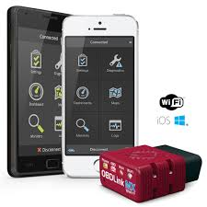
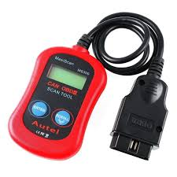
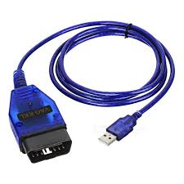
OBD-II
Scan Tools.

Slide 104
OBD-II
CAN Bus
Vehicle Network

Slide 105
CAN
Controller Area Network.
Bus allowing communications between ECU’s inside the vehicle.
Message Based Protocol (Frame).
Carrier Sense Multiple Access with Collision Avoidance (CSMA/CA).
Not only communications protocol implemented in vehicles (cf LIN, MOST) but most common.
https://en.wikipedia.org/wiki/CAN_bus

Slide 106
OBD-II
Vehicle Network

Slide 107
Security Issues

Slide 108
Security Issues
No source address => No certainty about origin.
Broadcast nature => Information Disclosure.
Prioritized ID’s => Denial of Service.
No support for encryption or authentication.
’CAN, by design, offers no protection from manipulation’
(Miller, 2013), (Koscher, 2010)

Slide 109
Threat Model
Physical Access to OBD-II DLC.
Ability to inject arbitrary packets.
Able to exploit vulnerabilities in ECU software.
Enable wireless connectivity.
Vehicle Network

Slide 110
Proposed Solution: OBD-II Role Based Access Control

Slide 111
Solution
Proposed solution: Role Based Access Control.
Every role determines what kind of access is permitted.
For example:
Repair shop => Read diagnostics information only.
Official dealership => Diagnostics + ability to fix/test faulty ECU’s.
Police => Check integrity of vehicle network.

Slide 112
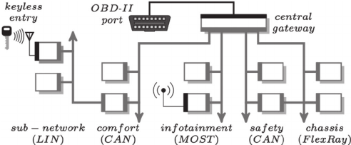
Solution
Central gateway (CGW).
Acts as router for all subnetworks + gate for all incoming data.
Perfect place to implement access control solution.

Slide 113
Private keys
Central Server
Internet
Connection
Central Gateway
Sub-Networks
CAN
User
Public Key
Intra Vehicle Network

Slide 114
Solution
Central Gateway
Sub-Networks
CAN
User
Attacker
Intra Vehicle Network

Slide 115
Solution
Central Gateway
Sub-Networks
CAN
Attacker
Intra Vehicle Network

Slide 116
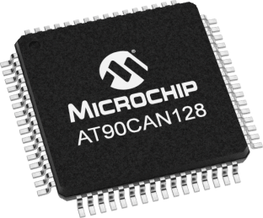
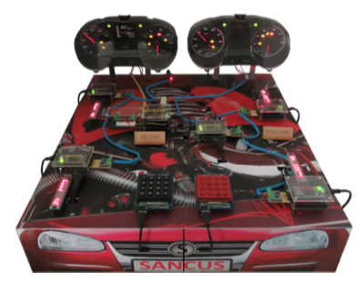
Solution
Implementation:
Microcontroller with CAN controller (AT90CAN128).
CAN Transceiver.
OBD-II connector.
Demo:
CAN testbench designed at KuLeuven for testing VulCAN.
Jo Van Bulck, Jan Tobias Mühlberg, and Frank Piessens
December 2017

Slide 117
Planning Next Three Months

Slide 118
Planning
December:
Get Familiar with Microcontroller software development.
Write December paper/poster.
January & February:
Implement a simple CAN compliant device.
Start Implementing rudimentary access control.

Slide 119
Questions? Notes: - Timing.

Slide 120
Timing difficulties.
Major Challenges!: Key infrastructure, Key size, …
No Slowing Down!!!

Slide 121
CAN Protocol

Slide 122
CAN
Controller Area Network.
Bus allowing communications between ECU’s inside the vehicle.
Message Based Protocol.
Carrier Sense Multiple Access with Collision Avoidance (CSMA/CA).
Not only communications protocol implemented in vehicles (cf LIN, MOST) but most common.

Slide 123
CAN Frame
Name | SOF | ID | RTR | IDE | r0 | DLC | Data | CRC | CRCd | ACK | EOF
No. Bits | 1 | 11 | 1 | 1 | 1 | 4 | 64 | 15 | 1 | 2 | 7
Identity Field
Used to identify each ECU in the vehicle.
Also specifies a priority (Lowest ID = highest priority).
Bitwise contention resolution (1 = Recessive & 0 = Dominant).

Slide 124
CAN Bitwise Contention Resolution
1 | 1 | 0 | 1 | 0 | 0 | 1 | 1 | 0 | 1 | 0
0 | 0 | 1 | 0 | 1 | 0 | 1 | 1 | 0 | 1 | 0
Node 1
Node 3
0 | 1 | 0 | 1 | 1 | 1 | 1 | 1 | 0 | 0 | 1
0 | 0 | 0 | 1 | 0 | 0 | 0 | 0 | 1 | 1 | 0
Node 2
Node 4
Value Transmitted: 0

Slide 125
CAN Bitwise Contention Resolution
1 | 1 | 0 | 1 | 0 | 0 | 1 | 1 | 0 | 1 | 0
0 | 0 | 1 | 0 | 1 | 0 | 1 | 1 | 0 | 1 | 0
Node 1
Node 3
0 | 1 | 0 | 1 | 1 | 1 | 1 | 1 | 0 | 0 | 1
0 | 0 | 0 | 1 | 0 | 0 | 0 | 0 | 1 | 1 | 0
Node 2
Node 4
Value Transmitted: 0

Slide 126
CAN Bitwise Contention Resolution
1 | 1 | 0 | 1 | 0 | 0 | 1 | 1 | 0 | 1 | 0
0 | 0 | 1 | 0 | 1 | 0 | 1 | 1 | 0 | 1 | 0
Node 1
Node 3
0 | 1 | 0 | 1 | 1 | 1 | 1 | 1 | 0 | 0 | 1
0 | 0 | 0 | 1 | 0 | 0 | 0 | 0 | 1 | 1 | 0
Node 2
Node 4
Value Transmitted: 0

Slide 127
CAN Bitwise Contention Resolution
1 | 1 | 0 | 1 | 0 | 0 | 1 | 1 | 0 | 1 | 0
0 | 0 | 1 | 0 | 1 | 0 | 1 | 1 | 0 | 1 | 0
Node 1
Node 3
0 | 1 | 0 | 1 | 1 | 1 | 1 | 1 | 0 | 0 | 1
0 | 0 | 0 | 1 | 0 | 0 | 0 | 0 | 1 | 1 | 0
Node 2
Node 4
Value Transmitted: 1

Slide 128
CAN Frame
Name | SOF | ID | RTR | IDE | r0 | DLC | Data | CRC | CRCd | ACK | EOF
No. Bits | 1 | 11 | 1 | 1 | 1 | 4 | 64 | 15 | 1 | 2 | 7
Data Field
Carries the payload.
Length is 64 so only 8 bytes of data in each message.

Slide 129
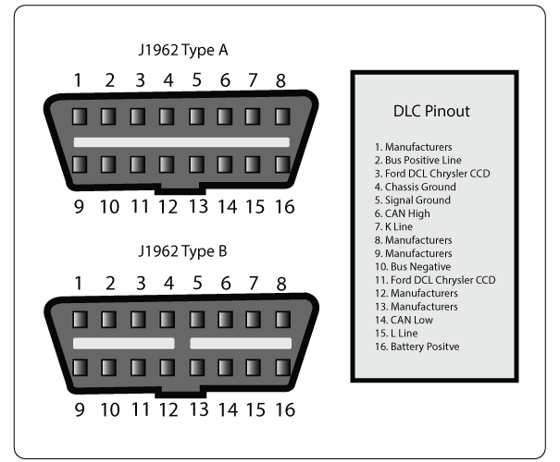
OBD-II

Slide 130
OBD-II
Parameter ID’s (PID)
Codes to request data from a vehicle.
Typical Use (with scan tool connected to DLC):
Technician enters PID on the scan tool.
PID is sent to the CAN bus (accessed via the DLC).
Some ECU recognises the PID and reports the corresponding value on the bus.
Scan tool reads response and displays it to the technician.

Slide 131
OBD-II
Parameter ID’s (PID)
Codes to request data from a vehicle.
Typical Use (with scan tool connected to DLC):
Technician enters PID on the scan tool.
PID is sent to the CAN bus (accessed via the DLC).
Some ECU recognises the PID and reports the corresponding value on the bus.
Scan tool reads response and displays it to the technician.

Slide 132
Security Issues
Potential hacking results (safety critical).
Driver Distractions (wipers etc.).
Engine shutoff.
Steering changes.
…

Slide 133
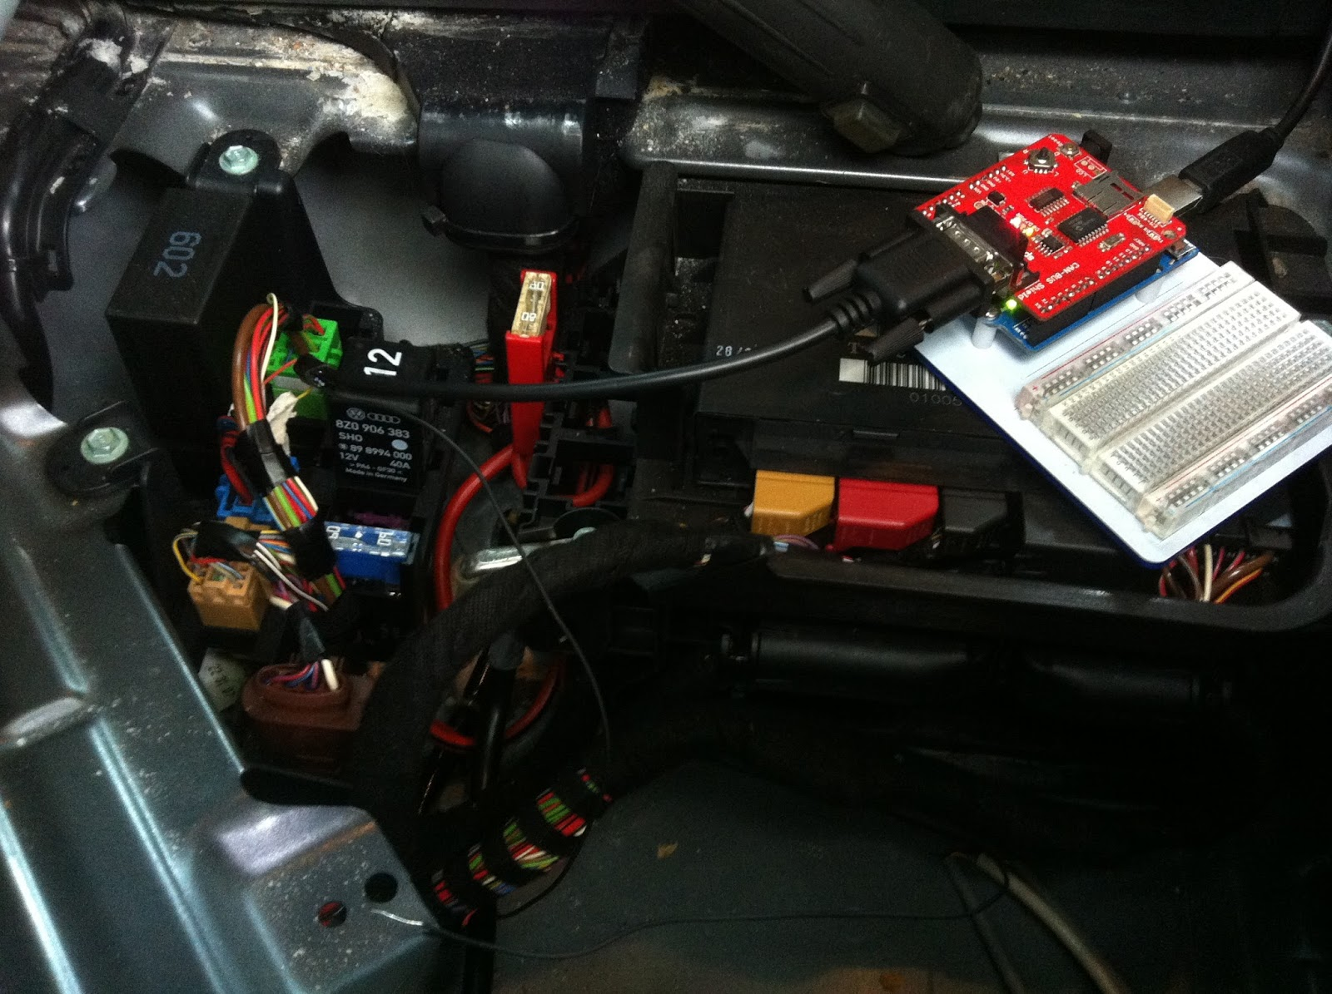
Physical Access
Impossible to completely deny physical access.
Solutions rely on reducing potential harm of unauthorized access:
Seed-key mechanism
Two-way authentication between ECU’s.
Timer method.
Intrusion detection system.
Honeypot.
VulCAN.

Slide 134

Bluetooth
Standard Bluetooth security not sufficient.
Large protocol stack, so susceptible to multiple attacks:
Cipher attacks, Bluejacking, Backdoor attack, etc.
Solutions should apply to the Bluetooth implementation used inside the vehicle.

Slide 135
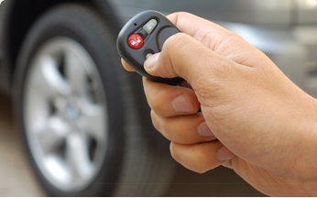
Remote Keyless Entry
Most cars today use RF-based remote keyless entry (RKE)
radio transmitter sends encrypted data containing identifying information.
The ECU can determine if the key is valid and lock, unlock, and start the vehicle

Slide 136
Tire Pressure Monitoring System
Each tire has pressure sensor.
Transmits real time data to an ECU.
Radio signal can be blocked/mimicked.
Solution: ?

Slide 137
Distributed Software

Slide 138
Secure Software & Systems

